Slide 1

Day 1: Career Overview - Data Scientist
By Karishma Popli

Slide 2
Agenda:
What is Analytics?
Introduction to the Analytics Landscape
Prominent Roles in the Data Industry
Analytics Maturity Level
Why choose Data Science as a career option?
5 mins break.
How to become a data scientist with no experience
Your learning journey ahead!
Excel - Quickest way to start learning Data Analysis
Power BI – Fancy way of storytelling

Slide 3
What is Analytics?
“The extensive use of data, statistical and quantitative analysis, exploratory and predictive models and fact-based management to drive decisions and actions.” - Thomas Davenport
In a business context, the importance of analytics cannot be overstated. It is used to examine and understand historical patterns and to predict and improve future business practices. As such, is integral to the success of any organization, hence the widespread demand for analytics experts. For instance, a call centre manager analyses his team’s performance data for resource optimization. HR managers use employee data to predict attrition.
Broadly, analytics is classified into two types – descriptive and predictive.
Descriptive analytics is used to analyse and derive insights from past data whereas predictive analytics is used to study trends and predict what will happen in the future.

Slide 4
Introduction to the Analytics Landscape
Data Engineers
Business Analysts
Data Scientists
Data Analysts

Slide 5
Prominent Roles in the Data Industry
Data Engineer - The role in any analytics setup responsible for creating robust pipelines to make sure that the team of analysts and scientists get the right and relevant data to work on is a data engineer. A data engineer is the first line for any analytics project, making sure that the right data is extracted from the right sources using the right tools. Once the data is captured, the next step of the process is the analysis.
Business Analyst - A key player in the analysis process is the business analysts. These professionals traditionally looked after helping organisations building strategies based on the insights they develop from their current business, their experience so far and their gut feel. However, with the advent of new technologies and with the increase in data, organisations can now leverage their data and draw meaningful conclusions out of it to study their current business and plan for their future. Once they devise technical solutions and set up the evaluation metrics designed for the problem, it is also their task to explain all the insights drawn to the higher management. This is done with good visualisation and communication and data storytelling skills. They, of course, need to have a stronghold on some business processes as well.
Data Analyst - A data analyst is often asked to work on business problems involving data with complexity and therefore it is imperative that they not only understand how to program the techniques well but also understand what techniques should be used in what kind of a business problem. They perform a rigorous analysis and interpret conclusions that not only help the organisation solve the business problem but also set some policies for them in the data-driven approaches they adopt in the near future.
Data Scientist - Like any other scientist, a data scientist has a fair few numbers of tools in her arsenal, which he/she uses based on the situation. For example, if the problem is obvious enough, it can be solved using a simple visualisation, which will be made in a BI tool like tableau or even MS Excel to some extent. As the problem becomes more complex, the tools to be used to crack them become more sophisticated. They might range from the plain vanilla logistic regression to an ensemble of neural networks built to utilise data coming from an NLP functioning.

Slide 6

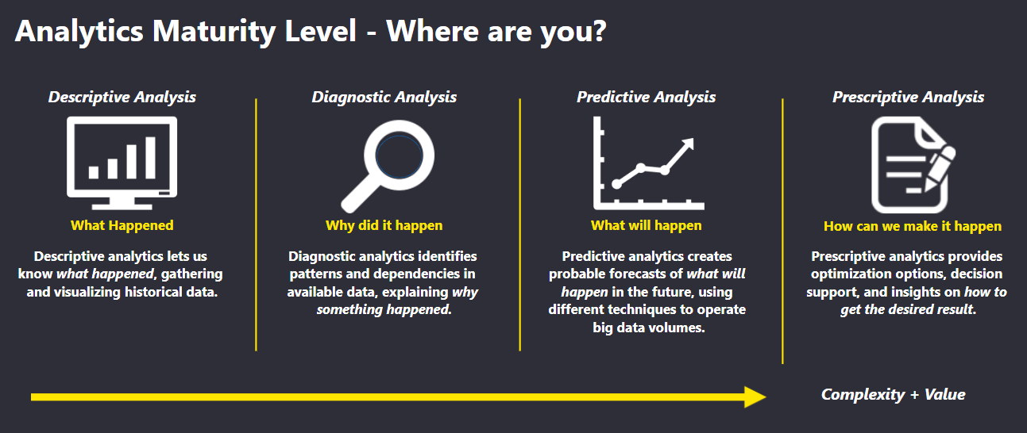
Analytics Maturity Level

Slide 7
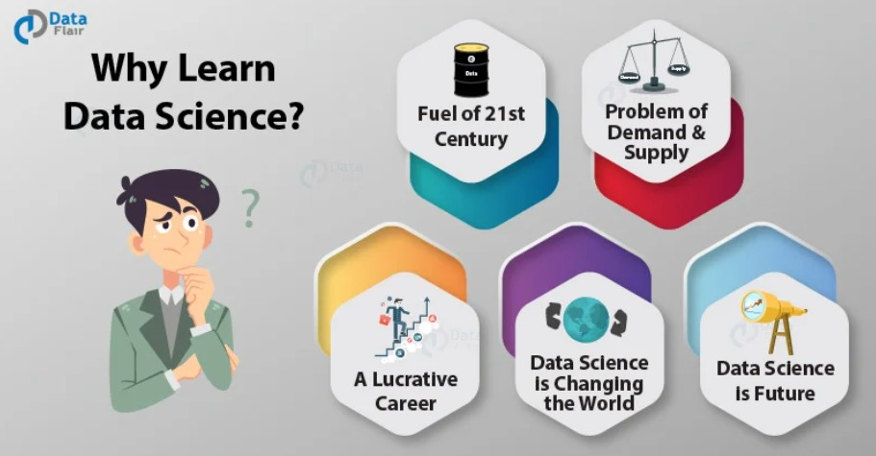

Why choose Data Science as a career option?

Slide 8
Sit Stretch and Relax

Slide 9
How to become a data scientist with no experience
Work on your Maths Skill
Learn Programming Languages
Build your resumes with internships
Participate in Hackathons
Start by being a data analyst
Learn new technologies, Practice, Read books and Repeat!

Slide 10
Learning Journey Ahead:
Excel
Power BI.

Slide 11
Excel - Quickest way to start learning Data Analysis
Excel is the most powerful tool to manage and analyze various types of Data.
Microsoft Excel is a spreadsheet program used to record and analyze numerical and statistical data. Microsoft Excel provides multiple features to perform various operations like calculations, pivot tables, graph tools, macro programming, etc. It is compatible with multiple OS like Windows, macOS, Android and IOS.
Basic Details – Ribbon, BIU, Data type
How To Perform Arithmetic Operations in Excel – Addition, subtraction, divide, multiply, percentage etc
Filter
Insert picture, images etc
Charts

Slide 12
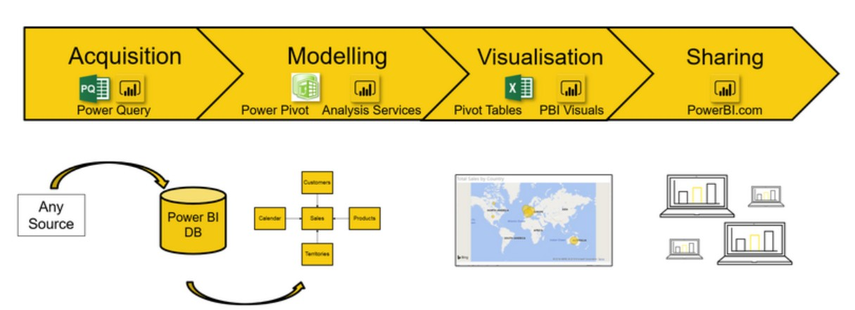
Power BI – Fancy way of storytelling

Slide 13
Any Questions?

